Slide 1

SystemVerilog (SV)
Oklahoma State University
Electrical and Computer Engineering Department
Stillwater, OK 74078 USA
james.stine@okstate.edu

Slide 2

Acknowledgement

Slide 3
Logistics
These lectures will be split into 2 (maybe three), where we will cover the following:
Basics of SystemVerilog – what to do and what not to do!
Basics of Testing using Testbenches and good verification schemes.
Tutorial on sample simulation with Mentor Graphics ModelSim

Slide 4
Advice
Many of you have not had me for Digital Logic Design and that is okay.
However, you will have a steep learning curve if you procrastinate and do not try things asap.
I encourage you to try all the items that I use today and throughout the lecture and even tinker with some of the ideas.
Ask questions about certain features and other elements.
I do not know everything about ModelSim and SystemVerilog, but it is a very rich tool full of features that I will not have time to discuss – learn them as they may lead to help later.

Slide 5
Environmental Variables
Operating systems use environmental variables to help communicate information about a user and the location of items in their file structure.
One of the more important ones is for the license.
You need to set LM_LICENSE_FILE to 999@LICENSE.SERVER.edu to use the software.
If ModelSim does not run, its probably due to not setting this variable correctly.
Sometimes, ModelSim will not really give you much information if something is not set correctly or misspelled.
I just did a simple search on Google to learn how to change the environmental variables.

Slide 6
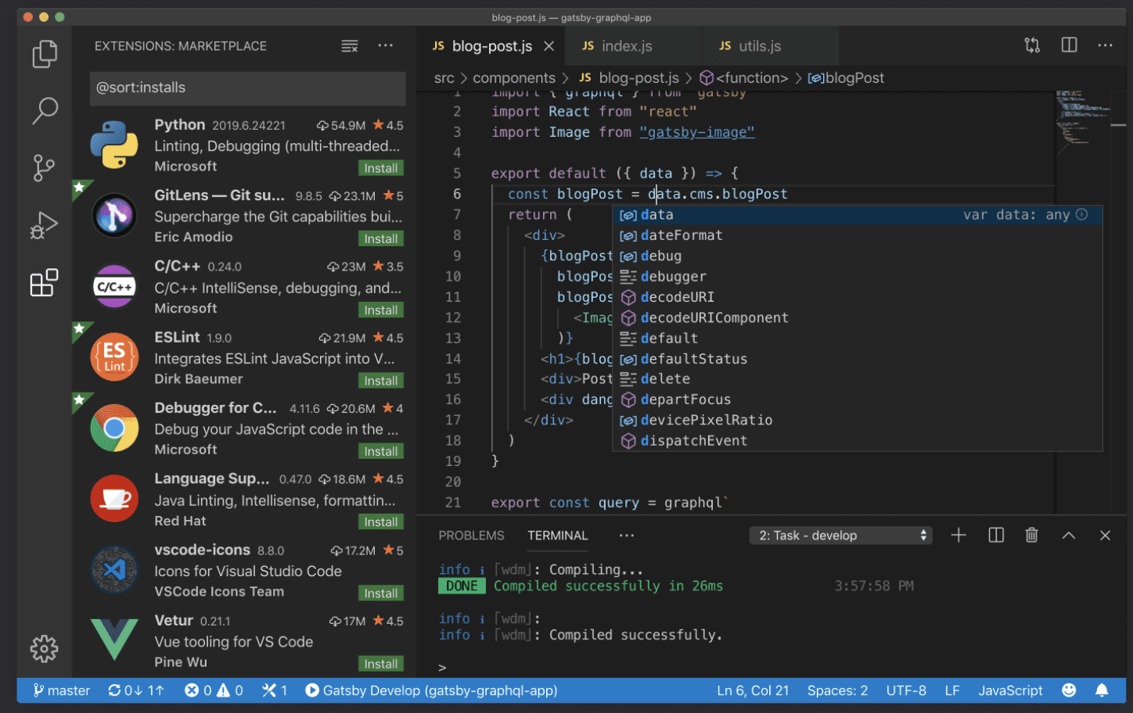
Text Editor
You will also need a text editor and how to use it well
Try to avoid simple ones like Notepad.
A really good one is Microsoft’s Visual Studio Code
https://code.visualstudio.com

Slide 7
Other Editors
Again, you will need a good text editor for this class.
Again, there is no right answer – I firmly feel that the best text editor is one you feel comfortable with.
Here are some suggestions:
Microsoft Visual Studio Code (https://code.visualstudio.com)
Notepad++ (Windows) (https://notepad-plus-plus.org)
Emacs (all platforms) (http://www.gnu.org/software/emacs/)
VIM/VI (all platforms) (http://www.vim.org)
Atom (https://atom.io)
Sublime Text (all platforms) (http://www.sublimetext.com)

Slide 8
MGC ModelSim
ModelSim has been around since I was an early graduate student, and it is an amazing piece of software.
It was previously owned by Mentor Graphics Corporation (MGC) but now is owned by Siemens.
It can do many things but also be complicated with many features.
You will need Parallels Desktop for Mac OS X Student Edition if you have a Mac.
I wish there was another solution here, but it is, what it is.
https://www.parallels.com/landingpage/pd/education/

Slide 9
Terminal
All simulations are run from the terminal.
https://devblogs.microsoft.com/commandline/windows-command-line-the-evolution-of-the-windows-command-line/
You can get to the terminal or command prompt by typing “cmd” in the box on the lower left-hand side of the Windows screen.
It should also work if you use the Power Shell
I would think theoretically it should work with the Windows Subsystem for Linux (WSL) but have not tried it, as well.
https://docs.microsoft.com/en-us/windows/wsl/about

Slide 10
MGC ModelSim vsim window

Slide 11
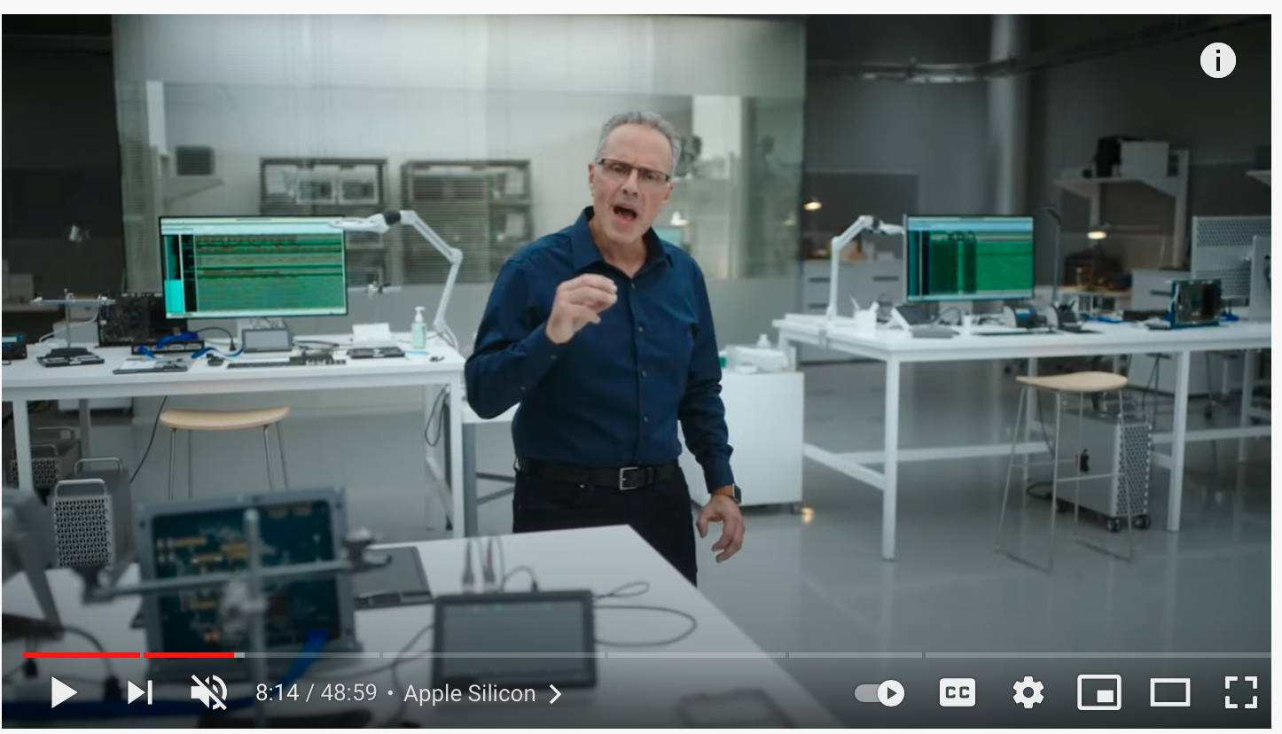
Coolness!
https://youtu.be/5AwdkGKmZ0I

Slide 12
Introduction
Hardware description language (HDL):
specifies logic function only
Computer-aided design (CAD) tool produces or synthesizes the optimized gates
Most commercial designs built using HDLs
Two leading HDLs:
SystemVerilog
developed in 1984 by Gateway Design Automation
IEEE standard (1364) in 1995
Extended in 2005 (IEEE STD 1800-2009)
VHDL 2008
Developed in 1981 by the Department of Defense
IEEE standard (1076) in 1987
Updated in 2008 (IEEE STD 1076-2008)

Slide 13
HDL to Gates
Simulation
Inputs applied to circuit
Outputs checked for correctness
Millions of dollars saved by debugging in simulation instead of hardware
Synthesis
Transforms HDL code into a netlist describing the hardware (i.e., a list of gates and the wires connecting them)
IMPORTANT:
When using a HDL, think of the hardware the HDL should produce. It is not coding nor should be thought of this way!

Slide 14
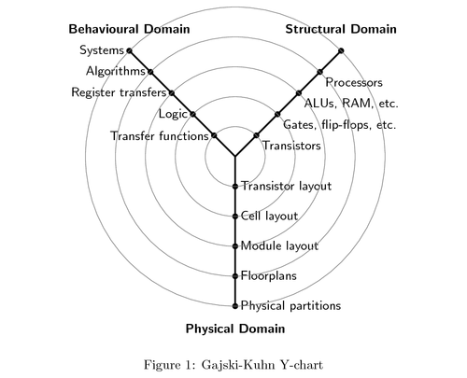
Gajski-Kuhn Y Diagram
Block Diagram
You cannot start an HDL design without a block diagram…period!
SV is a modeling language!
Gajski-Kuhn Diagram
Reiterates the process and the work required
Destination
Work required for your design (you want to minimize this) is how much the compiler has to wrap around converting from one domain to the other!

Slide 15
Synthesis
HDL
Synthesis
Forward-moving progress translating HDL into gates
Verification
Backward-moving progress checking to see that synthesis is indeed creating the design we want!
Hardware Compiler
Synthesis is typically handled by hardware compiler.
Translation
Optimization
Mapping
Most Popular Versions: Synopsys DesignCompiler, FPGA manufacturers (Altera, Xilinx, Actel), Synopsys Synplicity
Simulation is not hardware compiling!
We will working with simulation this semester!
Synthesis
Verification
Implementation

Slide 16
SystemVerilog Modules
Three types of Modules:
Behavioral: describe what a module does at a very high level
Structural: describe how it is built from simpler modules (START HERE!)
RTL: uses structural as a starting block and behavioral-elements to repeat them.
[Harris/Harris]

Slide 17

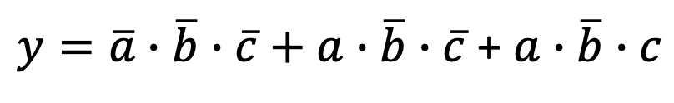
SystemVerilog Syntax
module example (input logic a, b, c,
output logic y);
assign y = ~a & ~b & ~c | a & ~b & ~c | a & ~b & c;
endmodule
Name of Digital Device or Module
Declaration of input/output can be done within parenthesis or in body of Verilog file (i.e., between module and endmodule)
Can put multiple modules in one file or have one module per one file. There is no right answer and the best option is one that you feel good about.
$y=\overline{a}∙\overline{b}∙\overline{c}+a∙\overline{b}∙\overline{c}$ + $a∙\overline{b}∙c$

Slide 18
Verilog
Verilog is almost the same as SystemVerilog, but sometimes people switch between the two.
You will also hear people say Verilog when they mean SV and vice-versa.
The standard indicates that both are the same even though they are not.
The syntax is almost the same except “input” is utilized instead of “input logic”.
Same applies for “output” and “output logic”
See Harris/Harris handout on Canvas for Verilog refresher.
The only way an EDA software knows the difference is due to the file extension.
Use .sv for SV
Use .v for Verilog

Slide 19
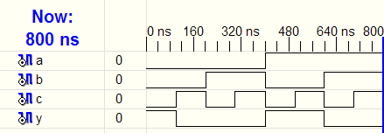
HDL Simulation
SystemVerilog:
module example(input logic a, b, c,
output logic y);
assign y = ~a & ~b & ~c | a & ~b & ~c | a & ~b & c;
endmodule
[Harris/Harris]

Slide 20
HDL Synthesis
SystemVerilog:
module example(input logic a, b, c,
output logic y);
assign y = ~a & ~b & ~c | a & ~b & ~c | a & ~b & c;
endmodule
Synthesis:
[Harris/Harris]

Slide 21
SystemVerilog Syntax
Case sensitive
Example: reset and Reset are not the same signal.
No names that start with numbers
Example: 2mux is an invalid name
Whitespace ignored
Comments:
// single line comment
/* multiline
comment */

Slide 22
Structural Modeling - Hierarchy
module and3(input logic a, b, c,
output logic y);
assign y = a & b & c;
endmodule
module inv(input logic a,
output logic y);
assign y = ~a;
endmodule
module nand3(input logic a, b, c
output logic y);
logic n1; // internal signal
and3 andgate(a, b, c, n1); // instance of and3
inv inverter(n1, y); // instance of inverter
endmodule
Why Hierarchy?
All items in a module are concurrent unless other specified! (order not important)
Each instance is called an instantiation!

Slide 23
John Backus [1924-2007]
Involved with early work in grammar and how to interpret values within software.
He along with a colleague Peter Naur came up with the most popular form of dealing within bits and bytes in digital systems.
We call this system the Backus-Naur Format or BNF invented in early 1960s or so.
As proposed by Backus, the formula defined "classes" whose names are enclosed in angle brackets.
There are many forms, but Verilog uses the form with a colon (:)
A[3:0] denotes a bus with 4 bits where 3 represents the MSB and 0 represents the LSB.
A bus is denoted by something that has more than 1 bit.
Some HDLs might use different but similar designations: A[3..0]

Slide 24
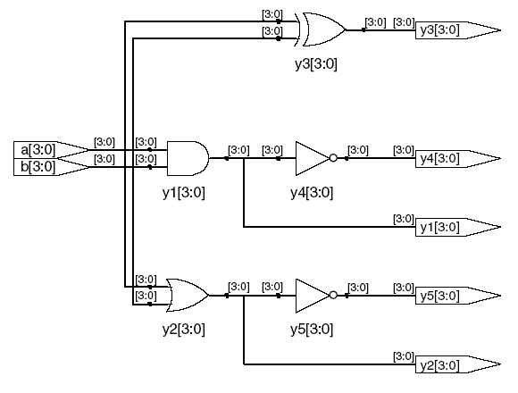
Bitwise Operators
module gates(input logic [3:0] a, b,
output logic [3:0] y1, y2, y3, y4, y5);
/* Five different two-input logic
gates acting on 4-bit busses */
assign y1 = a & b; // AND
assign y2 = a | b; // OR
assign y3 = a ^ b; // XOR
assign y4 = ~(a & b); // NAND
assign y5 = ~(a | b); // NOR
endmodule
// single line comment
/*…*/ multiline comment
[Harris/Harris]

Slide 25
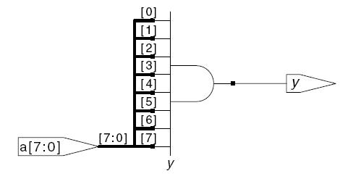
Reduction Operators and RTL
module and8(input logic [7:0] a,
output logic y);
assign y = &a;
// &a is much easier to write than
// assign y = a[7] & a[6] & a[5] & a[4] &
// a[3] & a[2] & a[1] & a[0];
endmodule
Ripping the bus!
As with the last example, you can sometimes, you can also let the language work for you when repeating elements – we call this Register Transfer Language or RTL constructs.
[Harris/Harris]

Slide 26
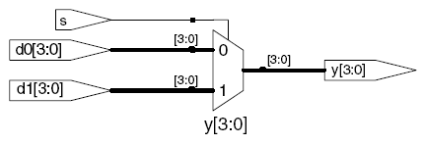
Conditional Assignment
module mux2(input logic [3:0] d0, d1,
input logic s,
output logic [3:0] y);
assign y = s ? d1 : d0;
endmodule
? : is also called a ternary operator because it
operates on 3 inputs: s, d1, and d0.
Notice RTL construct!
[Harris/Harris]

Slide 27
Internal Variables
module fulladder(input logic a, b, cin,
output logic s, cout);
logic p, g; // internal nodes
assign p = a ^ b;
assign g = a & b;
assign s = p ^ cin;
assign cout = g | (p & cin);
endmodule
Popular text editors (e.g., MS Studio Code) have formatting engines, color coding, and other nice options built in.
[Harris/Harris]

Slide 28
ICYMI: Internal Variables
Order of operations : important part of grammars
Highest
~ | NOT
*, /, % | mult, div, mod
+, - | add,sub
<<, >> | shift
<<<, >>> | arithmetic shift
<, <=, >, >= | comparison
==, != | equal, not equal
&, ~& | AND, NAND
^, ~^ | XOR, XNOR
|, ~| | OR, NOR
?: | ternary operator
Lowest
[Harris/Harris]

Slide 29

Internal Variables
Format: N'Bvalue
N = number of bits, B = base
N'B is optional but recommended (default is decimal)
[Harris/Harris]
Number | # Bits | Base | Decimal Equivalent | Stored
3'b101 | 3 | binary | 5 | 101
'b11 | unsized | binary | 3 | 00…0011
8'b11 | 8 | binary | 3 | 00000011
8'b1010_1011 | 8 | binary | 171 | 10101011
3'd6 | 3 | decimal | 6 | 110
6'o42 | 6 | octal | 34 | 100010
8'hAB | 8 | hexadecimal | 171 | 10101011
42 | unsized | decimal | 42 | 00…0101010

Slide 30
Internal Variables
assign y = {a[2:1], {3{b[0]}}, a[0], 6'b100_010};
// if y is a 12-bit signal, the above statement produces:
y = a[2] a[1] b[0] b[0] b[0] a[0] 1 0 0 0 1 0
// underscores (_) are used for formatting only to make it easier to read. SystemVerilog ignores them.
Most powerful part of Verilog in my opinion!

Slide 31
Z: Floating Output
SystemVerilog:
module tristate(input logic [3:0] a,
input logic en,
output logic [3:0] y);
assign y = en ? a : 4'bz;
endmodule
[Harris/Harris]

Slide 32
Delays
module example(input logic a, b, c,
output logic y);
logic ab, bb, cb, n1, n2, n3;
assign #1 {ab, bb, cb} = ~{a, b, c};
assign #2 n1 = ab & bb & cb;
assign #2 n2 = a & bb & cb;
assign #2 n3 = a & bb & c;
assign #4 y = n1 | n2 | n3;
endmodule
When does the last statement actually execute?
Delays are indicated from its previous declaration!

Slide 33
Delays
module example(input logic a, b, c,
output logic y);
logic ab, bb, cb, n1, n2, n3;
assign #1 {ab, bb, cb} =
~{a, b, c};
assign #2 n1 = ab & bb & cb;
assign #2 n2 = a & bb & cb;
assign #2 n3 = a & bb & c;
assign #4 y = n1 | n2 | n3;
endmodule
[Harris/Harris]

Slide 34
Sequential Logic
SystemVerilog uses Idioms to describe latches, flip-flops and FSMs
This is because these devices use feedback and SystemVerilog is a modeling language!!
Other coding styles may simulate correctly but produce incorrect hardware
Always check coding style manual for:
Latches/DFF
FSMs

Slide 35
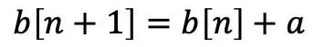
Two Datapath Types
Combinational (Parallel)
Sequential (Serial)
No node may be visited more than once!!!
Fast, but no storage!
Can put storage on the output/input to allow synchronization.
Output is connected somewhere to the input (at any level!)
In order to make sure sequential circuit outputs don’t interfere with inputs, you need to store it somewhere!
a
b
$$b\left[n+1\right]=b\left[n\right]+a$$

Slide 36
Timing : DFF vs. transparent latch
Draw lines where clock switches or transitions
Notice the delay!
[Harris/Harris]

Slide 37
Always Statement (from Verilog)
Anything that asserts/deasserts this list, will start from the always block and operate sequentially onward!
General Structure:
always @(sensitivity list)
statement;
Whenever the event in sensitivity list occurs, statement is executed
Asserts = an output caused from and input that is HIGH.
Deasserts = an output caused from an input that is LOW.
…related to logic levels!

Slide 38
D Flip-Flop
module flop(input logic clk,
input logic d,
output logic q);
always_ff @(posedge clk)
q <= d; // pronounced “q gets d”
endmodule

Slide 39
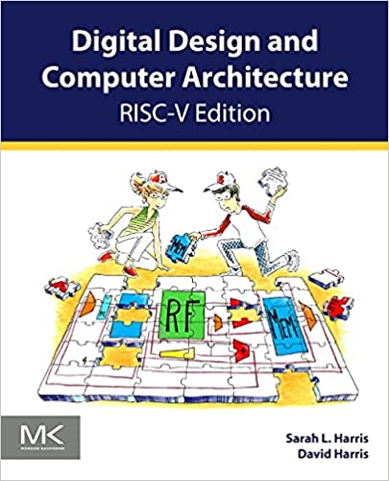
Re-use
I tend to use parts that are idioms, like DFFs, all the time.
So, I would check out the HDL on Canvas from the DDCA book and re-use as much as possible there.
I also encourage you to check out the free Chapter 4 from the older version of this book on Canvas
This is a super book that does the best job, in my opinion, of covering these topics.
[Harris/Harris]

Slide 40
Structural vs. RTL
You should all think about using structural as a fall back, however, RTL is an evolution of structural in that it takes a structural element and makes it easier to make larger blocks (can also be thought more behaviorally).
That is, it evolves the block around its bit width.
RTL or Register-Transfer Language coding is really the art of taking a structural element and making it larger for a given size.
No formal definition and hard to quantify.
Start with structural and evolve.

Slide 41
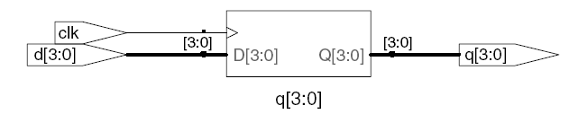
D Flip-Flop using RTL constructs
module flop(input logic clk,
input logic [3:0] d,
output logic [3:0] q);
always_ff @(posedge clk)
q <= d;
endmodule
Notice single structured repeated 4 times for word size!
[Harris/Harris]

Slide 42
Resettable D Flip-Flop
module flopr(input logic clk,
input logic reset,
input logic [3:0] d,
output logic [3:0] q);
// synchronous reset
always_ff @(posedge clk)
if (reset) q <= 4'b0;
else q <= d;
endmodule
[Harris/Harris]
Notice that reset is checked within the always module (it is hidden)

Slide 43
Resettable D Flip-Flop
module flopr(input logic clk,
input logic reset,
input logic [3:0] d,
output logic [3:0] q);
// asynchronous reset
always_ff @(posedge clk, posedge reset)
if (reset) q <= 4'b0;
else q <= d;
endmodule
What is different?
[Harris/Harris]

Slide 44
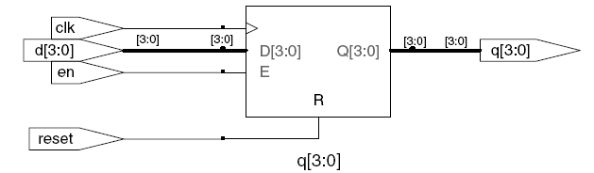
D Flip-Flop with Enable
module flopren(input logic clk,
input logic reset,
input logic en,
input logic [3:0] d,
output logic [3:0] q);
// asynchronous reset and synchronous enable
always_ff @(posedge clk, posedge reset)
if (reset) q <= 4'b0;
else if (en) q <= d;
endmodule
[Harris/Harris]

Slide 45
Latch
module latch(input logic clk,
input logic [3:0] d,
output logic [3:0] q);
always_latch
if (clk) q <= d;
endmodule
Warning: We don’t use latches in this course (so do most companies). But you might write code that inadvertently implies a latch. Check synthesized hardware – if it has latches in it, there’s an error.
Always check your log files after an EDA tool runs!!!!
[Harris/Harris]

Slide 46
Comparator
module comparator(input logic [1:0] val1,
input logic [1:0] val2,
output logic equal);
assign equal = (val1 == val2);
endmodule

Slide 47
D Flip-Flop with Enable
Statements that must be inside always statements:
if / else
case, casez

Slide 48

Behavioral Coding
Coding with behavior is extremely dangerous!
It tends to lead to bad coding and bad implementations!
Use behavior sparingly and only within RTL or code that is deemed allowable (e.g., DFF).
Some behavior coding based on Verilog 2001 standard has made combinational and subsequently sequential logic easier to code (see on next couple of slides)!
FSM and registers always have behavior coding!
Don’t mess with them!

Slide 49
Behavioral Coding
If you are trying to code something behaviorally, try to use simplistic always blocks.
Use sensitivity lists that are one variable, at most, if possible.
Simple if, else.
Test the code before using!
Again, try to resist the temptation to code things behaviorally and either use structural or RTL coding!
Never, ever, ever Google for code!
You can, however, Google block diagrams and other logic architectures to turn into HDL implementations.
If you feel tempted, take a break – it will bite you later if you copy something!
Early programmers took classes or functions and made them blank to give them an idea of the structure – this is called “stubbing” – it is sometimes useful to get started.
Comparison of how good your code is to Google’d code is acceptable.

Slide 50
Combinational Logic using always
// combinational logic using an always statement
module gates(input logic [3:0] a, b,
output logic [3:0] y1, y2, y3, y4, y5);
always_comb // need begin/end because there is
begin // more than one statement in always
y1 = a & b; // AND
y2 = a | b; // OR
y3 = a ^ b; // XOR
y4 = ~(a & b); // NAND
y5 = ~(a | b); // NOR
end
endmodule
This hardware could be described with assign statements using fewer lines of code, so it’s better to use assign statements in this case.
However, its sometimes easier, especially for decoding logic, to do this for easy reading and debugging.

Slide 51
Combinational Logic using case
module sevenseg(input logic [3:0] data,
output logic [6:0] segments);
always_comb
case (data)
// abc_defg
0: segments = 7'b111_1110;
1: segments = 7'b011_0000;
2: segments = 7'b110_1101;
3: segments = 7'b111_1001;
4: segments = 7'b011_0011;
5: segments = 7'b101_1011;
6: segments = 7'b101_1111;
7: segments = 7'b111_0000;
8: segments = 7'b111_1111;
9: segments = 7'b111_0011;
default: segments = 7'b000_0000; // required
endcase
endmodule
Just like a Truth Table – no need to simplify the Boolean logic
Forgetting this item may result in a latch being inferred.

Slide 52
Combinational Logic using case
case statement implies combinational logic only if all possible input combinations described
Remember to use default statement

Slide 53
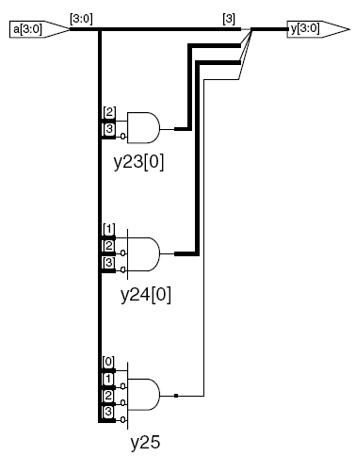
Combinational Logic using casez
module priority_casez(input logic [3:0] a,
output logic [3:0] y);
always_comb
casez(a)
4'b1???: y = 4'b1000; // ? = don’t care
4'b01??: y = 4'b0100;
4'b001?: y = 4'b0010;
4'b0001: y = 4'b0001;
default: y = 4'b0000;
endcase
endmodule
[Harris/Harris]

Slide 54
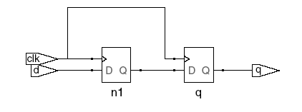
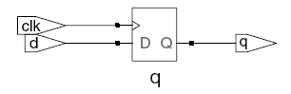
Blocking vs. Nonblocking Assignment
<= is nonblocking assignment
Occurs simultaneously with others
= is blocking assignment
Occurs in order it appears in file
Now you know why behavior coding is bad!
// Good synchronizer using
// nonblocking assignments
module syncgood(input logic clk,
input logic d,
output logic q);
logic n1;
always_ff @(posedge clk)
begin
n1 <= d; // nonblocking
q <= n1; // nonblocking
end
endmodule
// Bad synchronizer using
// blocking assignments
module syncbad(input logic clk,
input logic d,
output logic q);
logic n1;
always_ff @(posedge clk)
begin
n1 = d; // blocking
q = n1; // blocking
end
endmodule
[Harris/Harris]

Slide 55
Rules for Signal Assignment
Synchronous sequential logic: use always_ff @(posedge clk) and nonblocking assignments (<=)
always_ff @ (posedge clk)
q <= d; // nonblocking
Simple combinational logic: use continuous assignments (assign …)
assign y = a & b;
More complicated combinational logic: use always_comb and blocking assignments (=)
Assign a signal in only one always statement or continuous assignment statement.

Slide 56
Finite State Machines (FSMs)
Three blocks:
next state logic
state register
output logic (can be combined within next state logic)
[Harris/Harris]

Slide 57
FSM Example: Divide by 3
[Harris/Harris]
The double circle indicates the reset state

Slide 58

FSM in SystemVerilog
module divideby3FSM (input logic clk,
input logic reset,
output logic q);
typedef enum logic [1:0] {S0, S1, S2} statetype;
statetype [1:0] state, nextstate;
// state register
always_ff @ (posedge clk, posedge reset)
if (reset) state <= S0;
else state <= nextstate;
// next state logic
always_comb
case (state)
S0: nextstate = S1;
S1: nextstate = S2;
S2: nextstate = S0;
default: nextstate = S0;
endcase
// output logic
assign q = (state == S0);
endmodule
Two always blocks : one for next state logic and one for registers!
Can have begin/end within each state!
Can combine within next state logic!

Slide 59
Counters
module counter (input logic clk,
input logic reset,
output logic Vout);
logic [17:0] q;
always_ff @ (posedge clk, posedge reset)
begin
if (reset)
begin
q <= 0;
Vout <= 0;
end
else if (q < 56819)
begin
q <= q + 1;
Vout <= 1;
end
end
endmodule

Slide 60
Parameterized Modules
2:1 mux:
module mux2
#(parameter width = 8) // name and default value
(input logic [width-1:0] d0, d1,
input logic s,
output logic [width-1:0] y);
assign y = s ? d1 : d0;
endmodule
Instance with 8-bit bus width (uses default):
mux2 mux1(d0, d1, s, out);
Instance with 12-bit bus width:
mux2 #(12) lowmux(d0, d1, s, out);

Slide 61
Interfacing to Simulation
ModelSim, like most EDA pieces of software, use Tool Control Language (Tcl) to run stuff.
Tcl is a free interface introduced by John Ousterhout and has been popular for a long time.
Unfortunately, I do not see most EDA tools going away from using it, so I would recommend learning what you need to be successful.
All scripts run through the Tcl file called a DO file.
Always use a DO file!

Slide 62
Tcl (Tool Command Language) history
Developed in late 1980s by John Ousterhout at UC Berkeley
If you took my ECEN 4303 class, you used Magic, which was also written by John Ousterhout.
John was also a Professor at Berkeley, but later moved to be Chief Technology Office at Sun Microsystems
As stated earlier, Tcl is the main staple for most tools, because it can work with tools that have already have a graphical user interface (GUI).
That is, higher-level programs can interface Tcl as well as the “wish” interface for GUIs.
It’s a win-win not to mention it has a built-in interpreter.
Disclaimer: I had no original formal training on Tcl; I just had to learn it and I am not an advanced user by any stretch of the imagination, but I know enough to make me dangerous.
It is probably advisable just to try things.
See document on Cavnas.

Slide 63
Two Language Approach
0
Program size, complexity, reuse
1
C
Tcl
Use Tcl for scripting, C or C++ for large things.
Goals for Tcl:
1. Minimal syntax: easy to learn and type.
2. Minimal structure: make things play together.
3. Simple interfaces to C/C++: extensibility.
This is the Key Feature for us!

Slide 64

Links
Silly SV
Try the silly SV HDL and DO file
My videos
on my YouTube channel (https://www.youtube.com/user/jlstine).
Experience, experience, experience
No exchanges, substitutes or refunds!

